Slide 1

AI Assitive Smart Cane
Project by:
Roll Number | Name of the Student
2411EC010070 | Y. Praneeth Ram
2411EC010112 | S. Vivek
2411EC010115 | N. Vishnu Prabath
Under the Guidance of
G. Anand Kumar
Dean of ECE, CS, IOT
Department of ECE
School of Engineering
Malla Reddy University
Hyderabad, Telangana, India

Slide 2
Content:
Abstract of the Project
Introduction & Problem Statement
System Analysis
Architectural Design
Implementation
Testing & Results
Next Iteration & Future Scope
Conclusion

Slide 3
Abstract
Our project is called AI Assistive Smart Cane, and we made it to help blind people while walking. The main idea is very simple: if there is something in front of the person, the cane should warn them before they hit it. We are using an ESP32 to control the whole system. The ultrasonic sensor checks the distance in front of the cane. When an object comes within 30 cm, the buzzer gives two beeps, and if it comes closer than 27 cm, the buzzer keeps beeping continuously. We also have a water sensor at the bottom of the cane, which can detect water or a wet surface. When water is detected, the vibration motors give a vibration that the person can feel through the handle. We are also using an MPU6050 to check the movement and position of the cane. We chose these components because they are simple, affordable, and easy to control using the ESP32. Our main goal is to make a normal cane more useful by giving the user sound and vibration warnings about things they may not be able to see.

Slide 4
Introduction & Problem Statement
1.1 Problem Definition & Description
Blind people may find it difficult to detect obstacles while walking.
They may not notice water or wet surfaces in their path.
A normal cane does not provide early warning about nearby obstacles.
Our smart cane uses sensors, a buzzer, and vibration motors to give simple warnings to the user.
1.2 Objective of the Project
  Aim of the Project
To develop a smart walking cane that helps blind and visually impaired people walk more safely.
To detect nearby obstacles and water using sensors.
To provide easy-to-understand buzzer and vibration warnings.
  Tasks &

Slide 5
Task and Deliverables
Connect and program the ESP32, ultrasonic sensor, water sensor, MPU6050, buzzer, and vibration motors.
Set the ultrasonic sensor to give different warnings based on the obstacle distance.
Add water detection and vibration feedback.
Build and test the complete circuit on the cane body.
Test the system in different walking conditions and improve its reliability.
1.3 Scope of the Project
The project focuses on developing a smart cane for blind and visually impaired people.
It can detect nearby obstacles using an ultrasonic sensor and give warnings through a buzzer.
It can detect water or wet surfaces using a water sensor and provide vibration feedback.
The MPU6050 can monitor the movement and position of the cane.
The project aims to make walking safer, easier, and more comfortable using simple and affordable components.

Slide 6
System Analysis
2. 1 Existing System
  Background & Literature Survey
Traditional white canes are commonly used by visually impaired people to detect obstacles while walking.
The user mainly detects obstacles by touching or sensing them with the cane.
Some modern smart canes use sensors, buzzers, and vibration motors to provide additional warnings.
These systems show that technology can make a normal cane safer and more useful.
  Limitations of the Existing System
Traditional canes may not provide early warning about obstacles.
They may not detect water or wet surfaces effectively.
The user may not get clear information about the distance of an obstacle.
Some smart cane systems can be expensive or complicated.
Therefore, our project focuses on a simple and affordable smart cane with obstacle detection, water detection, buzzer alerts, and vibration feedback.

Slide 7
2. 2 Proposed System
Our system uses an ESP32 to control the smart cane.
An ultrasonic sensor detects obstacles in front of the user.
A water sensor detects water or wet surfaces.
A buzzer and vibration motors give warnings to the user.
  Advantages of the Proposed System
Provides early obstacle warning.
Detects water or wet surfaces.
Gives both sound and vibration feedback.
Uses simple and affordable components.
Easy to use and suitable for a smart walking cane.
2. 3 Software & Hardware Requirements
  Software Requirements
Arduino IDE
ESP32 Board Package
Arduino C/C++
Machine Learning (ML)
MPU6050 Library

Slide 8
  Hardware Requirements
ESP32 DevKit V1
HC-SR04 Ultrasonic Sensor
MPU6050
Water Sensor
Buzzer
18650 Battery
Battery Holder
TP4056 Charging Module
5V Boost Converter
Perfboard
Connecting Wires
ON/OFF Switch
2. 4 Feasibility Study
Technical Feasibility: The project can be built using ESP32 and simple sensors.
Economic Feasibility: The components are affordable and easily available.
Operational Feasibility: The cane is simple to use and easy to operate.
Time Feasibility: The project can be completed within the available project time.

Slide 9
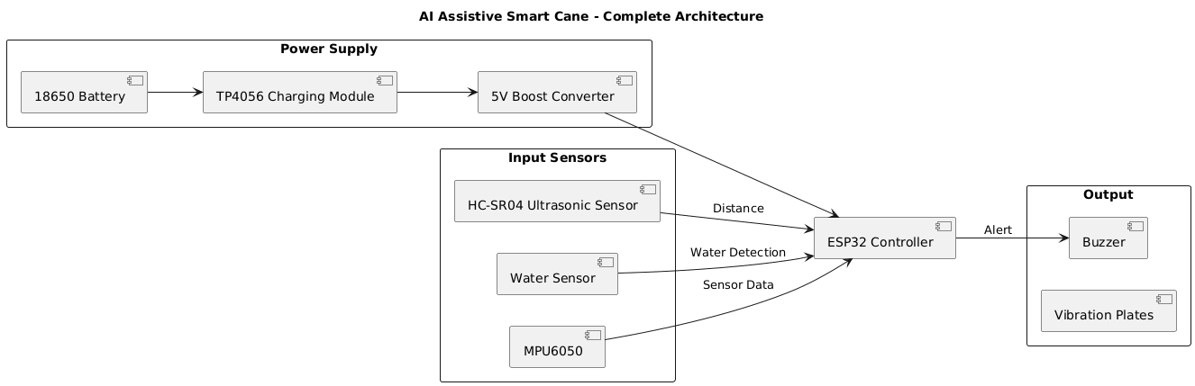
Architectural Design
3. 1 Project Architecture
  Complete Architecture Diagram (Class Diagram)

Slide 10
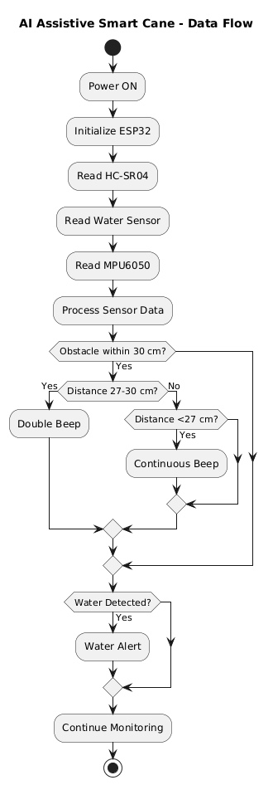
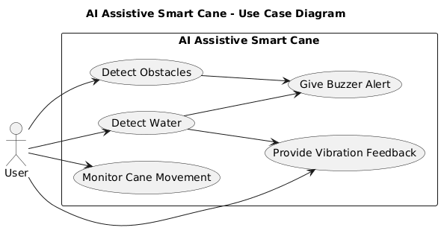
  Data Flow / Process Flow Diagram Use Case Diagram

Slide 11
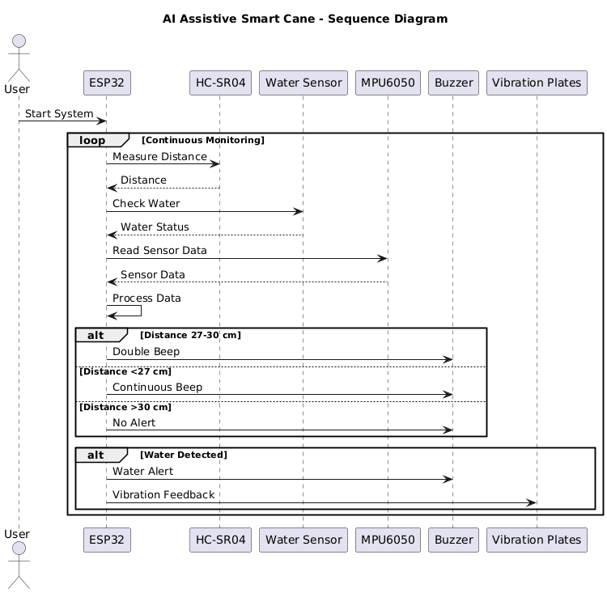
  Sequence Diagram

Slide 12
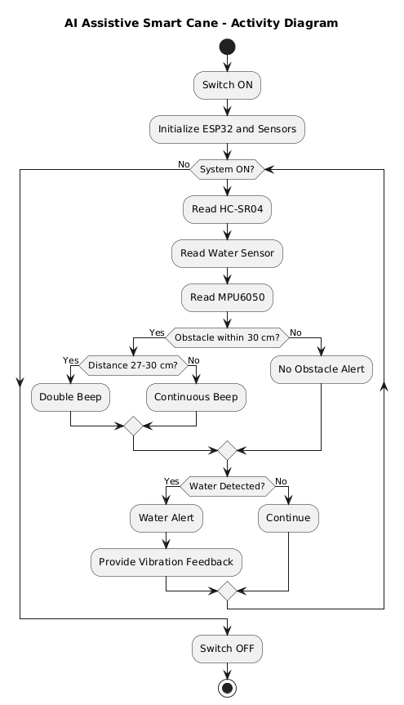
  Activity Diagram

Slide 13
3. 2 Justify Architecture Design Decisions
ESP32 is used as the main controller because it is affordable and easy to program.
HC-SR04 is used for obstacle detection.
Water Sensor is used to detect water or wet surfaces.
MPU6050 is used to monitor the cane movement.
Buzzer is used to give warning alerts.
Vibration Plates are used to provide vibration when water is detected.

Slide 14
Implementation
4. 1 Module Design
Obstacle Detection Module – HC-SR04 sensor detects obstacles.
Water Detection Module – Water sensor detects wet surfaces.
Motion Detection Module – MPU6050 monitors cane movement.
Alert Module – Buzzer gives warning to the user.
Control Module – ESP32 controls all the modules.
4. 2 Tools & Platforms
Arduino IDE
ESP32
Machine Learning (ML)
Arduino C/C++
MPU6050 Library

Slide 15
4. 3 Programming Languages & Frameworks
C/C++ – Used for ESP32 programming.
Arduino Framework – Used to program and control the sensors.
Machine Learning (ML) – Used for processing and analyzing sensor data.

Slide 16
Testing & Results
5. 1 Testing Methodology
  Key Scenarios Tested
Obstacle Detection – Checks whether the ultrasonic sensor detects obstacles.
Water Detection – Checks whether the water sensor detects water.
Buzzer Alert – Tests alerts at different obstacle distances.
MPU6050 Testing – Checks cane movement readings.
Vibration Plates – Checks the water alert mechanism through the plates
5. 2 Results
  Performance, Accuracy, & Efficiency
Performance- Detects obstacles and water using sensors.
Accuracy - Provides alerts based on sensor readings.
Efficiency- Uses ESP32 to process sensor data.
Overall Result- Aims to improve walking safety through buzzer alerts and vibration plates.

Slide 17
5. 3 Comparative Analysis
Traditional Cane | Our Smart Cane
Detects obstacles by touch | Detects obstacles using a sensor
No electronic alerts | Buzzer alerts
Limited water detection | Detects water using a sensor
Simple and low cost | Smart and affordable

Slide 18
Next Iteration & Future Scope
6. 1 Limitations of Current Version
Detects obstacles only within the sensor range.
Water detection depends on sensor contact with water.
Buzzer alerts may be hard to hear in noisy areas.
Battery requires regular charging.
Further testing is needed to improve accuracy.
6. 2 Improvements
  Features
Add voice alerts for obstacles.
Improve water detection.
Add fall detection using MPU6050.

Slide 19
  Optimizations
Improve sensor accuracy.
Reduce battery consumption.
Make the cane lightweight and easy to use
6. 3 Long-Term Vision
Add AI-based obstacle detection.
Introduce voice guidance for users.
Improve safety and sensor accuracy.
Make the smart cane affordable and easy to use.

Slide 20
Conclusion
The AI Assistive Smart Cane helps visually impaired people detect obstacles and water using sensors. The ESP32 processes sensor data and provides alerts through a buzzer and vibration plates. This project aims to make walking safer, easier, and more independent using affordable technology.

